Slide 1


The Traveling Salesman Problem
Guide:
E. Kalpana Mohammad Atif Hussain Assistant Professor 1601-12-733-039
CSE Department B.E 3/4 CSE C-1
CBIT, Gandipet.

Slide 2
What Is TSP?
The salesman should start at a point and travel all the places and come back to the starting point.
The salesman has to start from any one of the given city and has to return to the starting place with shortest distance or minimum cost.
The ultimate objective is to ‘Minimize The Traveling Cost’ and the basic requirement is that there should be communication between nodes.

Slide 3
Resolving TSP
Consider city 1 as the starting and ending point.
Generate all (n-1)! Permutations of cities.
Calculate cost of every permutation and keep track of minimum cost permutation.
Return the permutation with minimum cost.
Time Complexity: (n!)

Slide 4
Requirements
Hardware
Software
Pentium(R) Dual Core CPU T4200 @2.00 GHZ
Memory (RAM) 1.00 GB
System 32-bit Operating System Windows Vista
NetBeans IDE 8.0

Slide 5
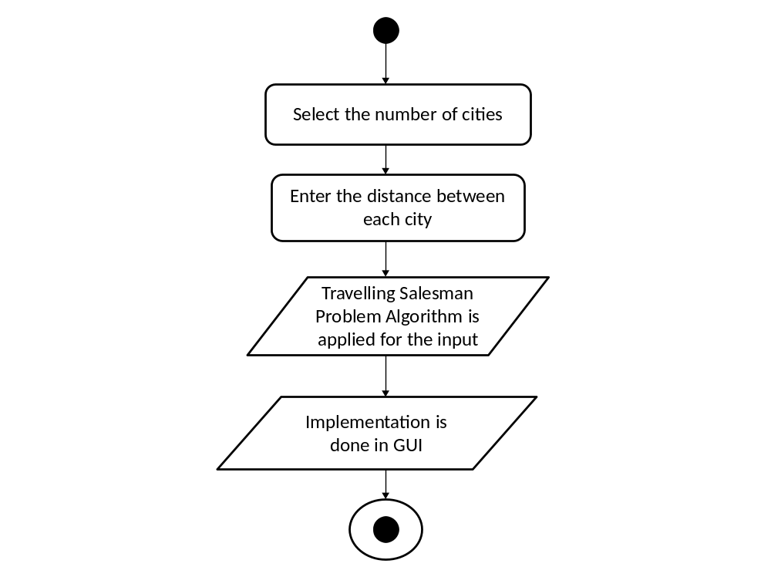
Activity Diagram

Slide 6
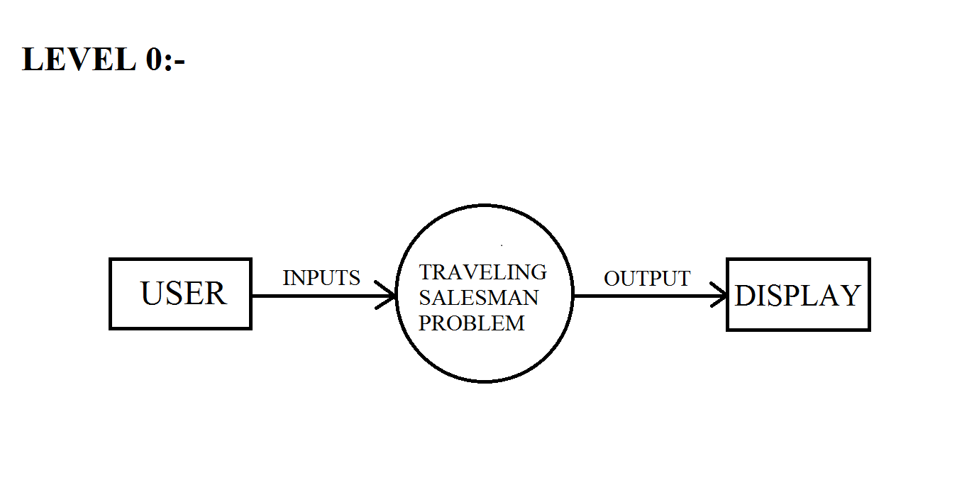
DFD
ADJACENCY MATRIX

Slide 7
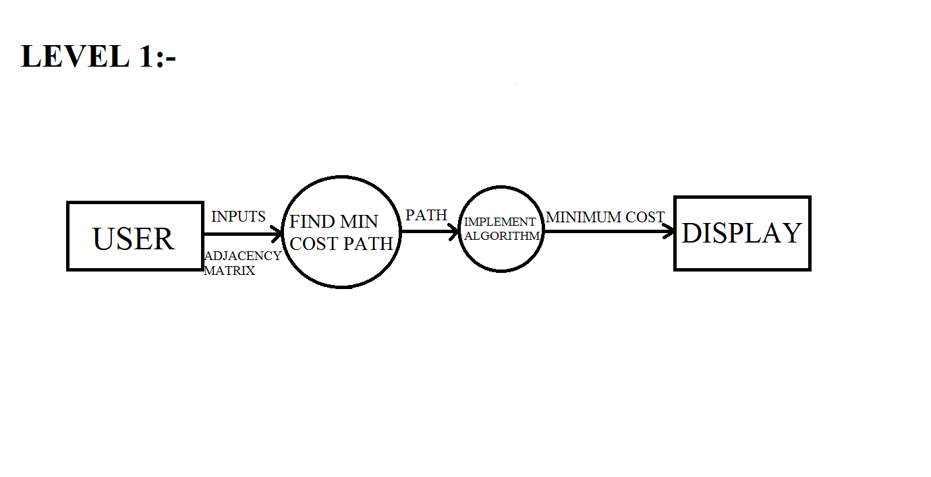
DFD

Slide 8
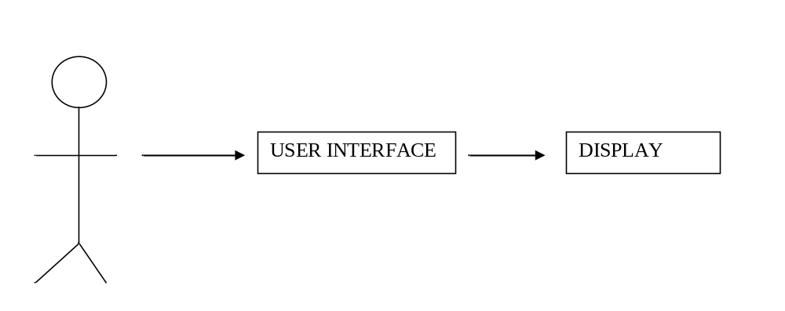
MODULES
USER MODULE DATA MODULE OUTPUT MODULE

Slide 9
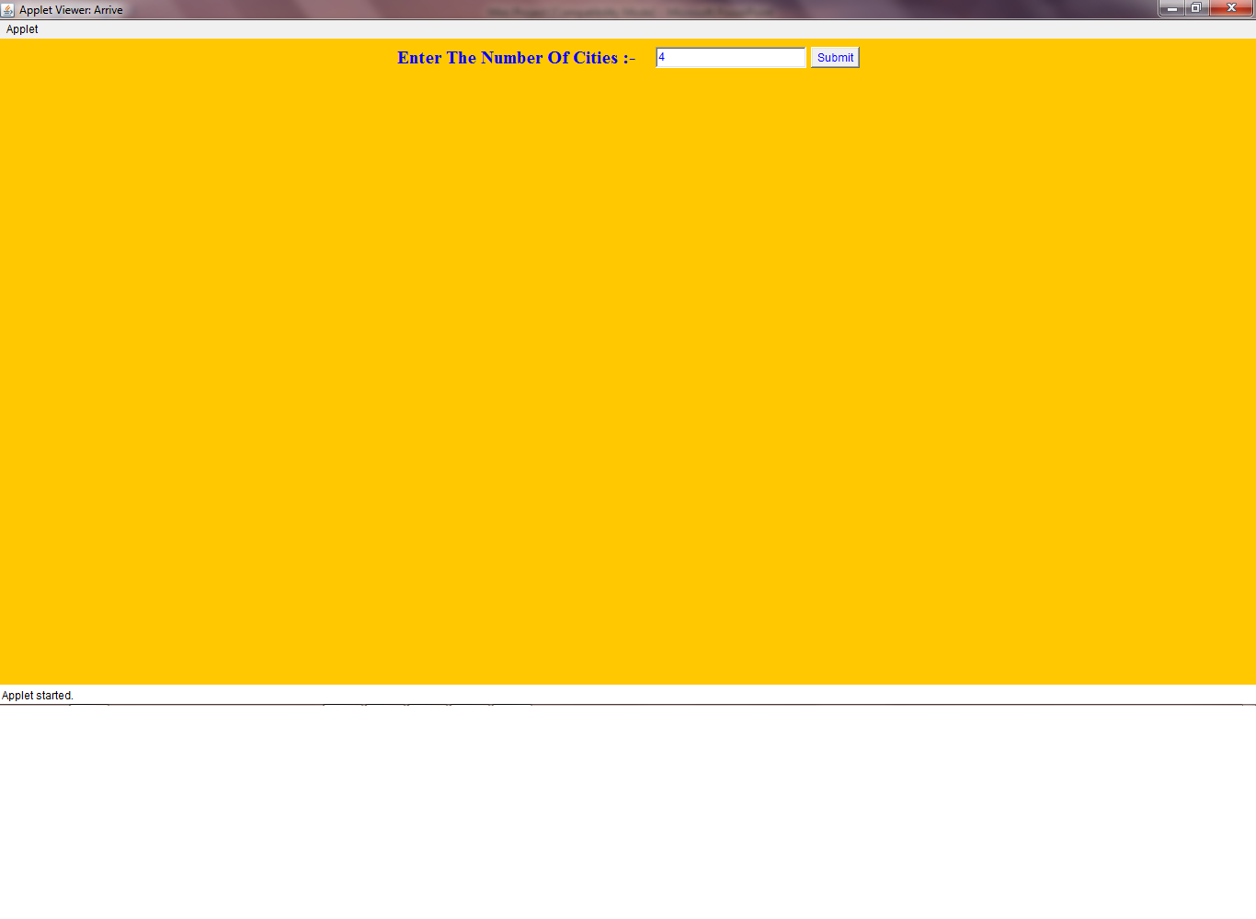
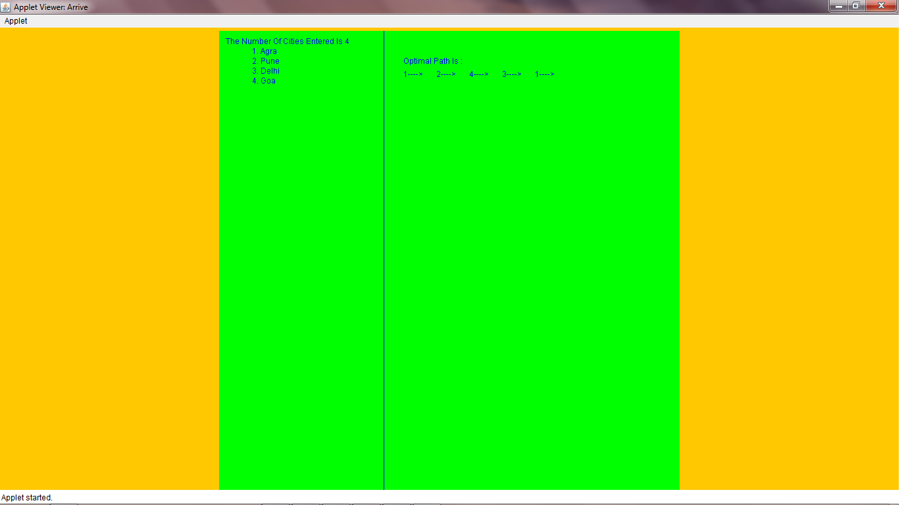
First Output Screen

Slide 10
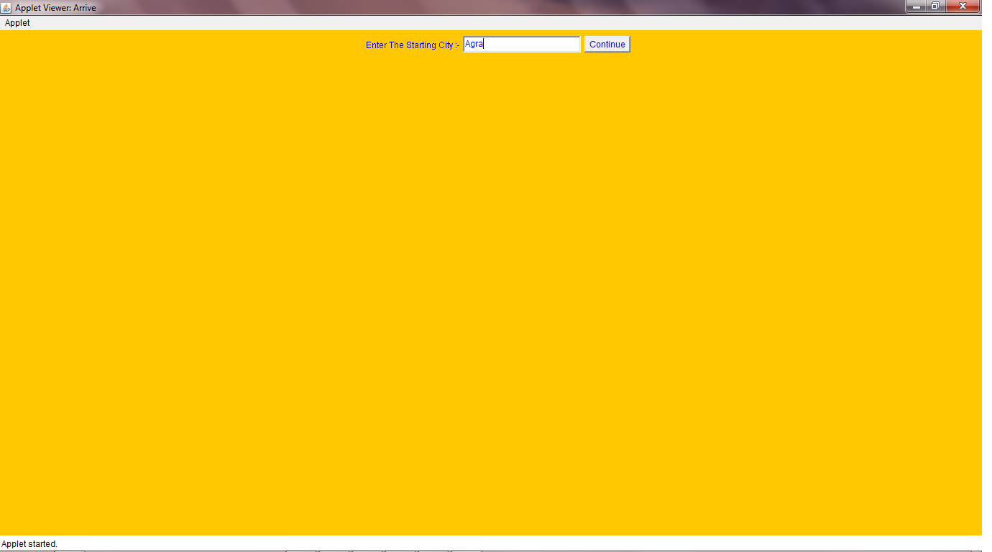
Initial City Is Entered

Slide 11
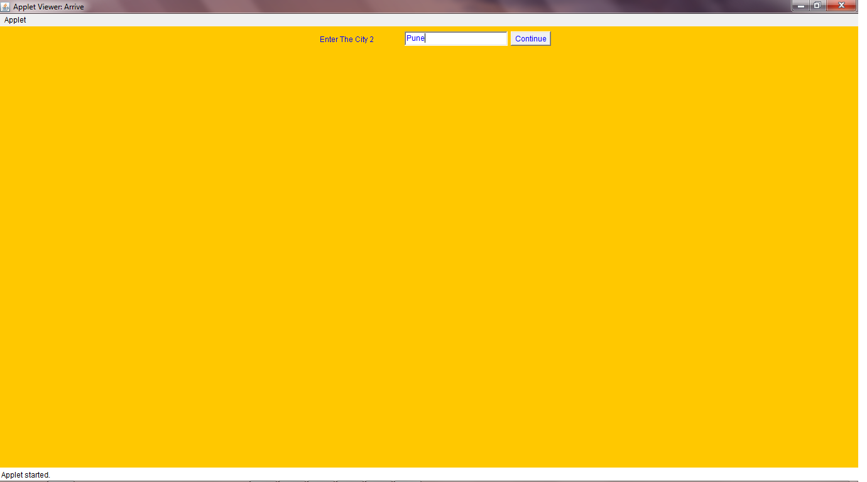
Next City Is Entered

Slide 12


Slide 13


Slide 14
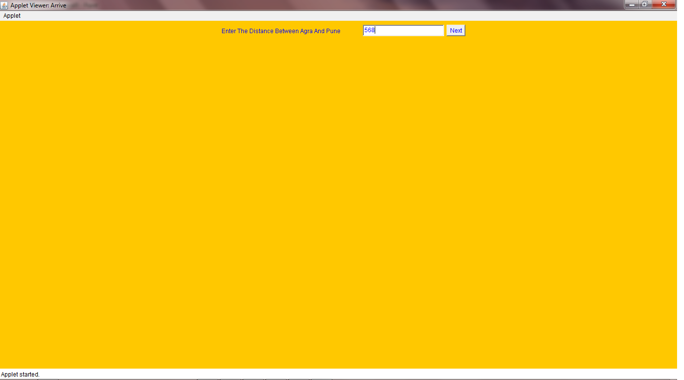
Distances Between Each Cities Are Entered

Slide 15


Slide 16
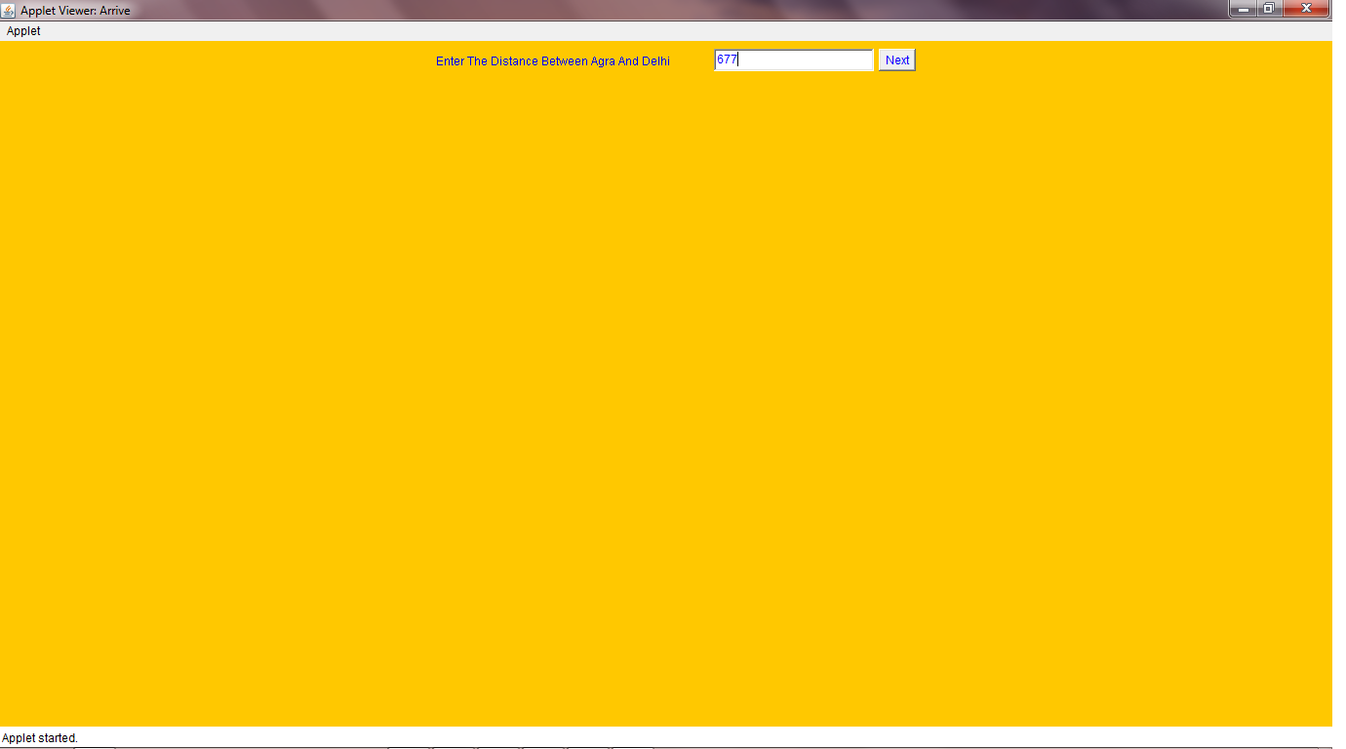

Slide 17


Slide 18


Slide 19


Slide 20
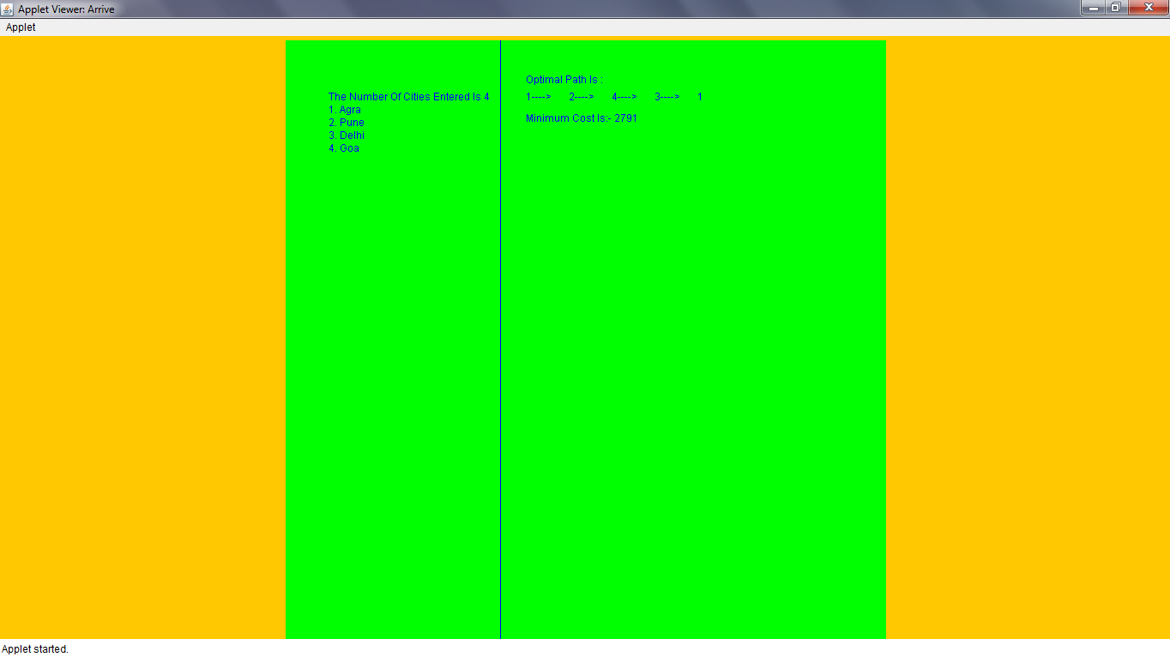
The Output Screen Shows The Optimal Path Along The Minimum Cost

Slide 21
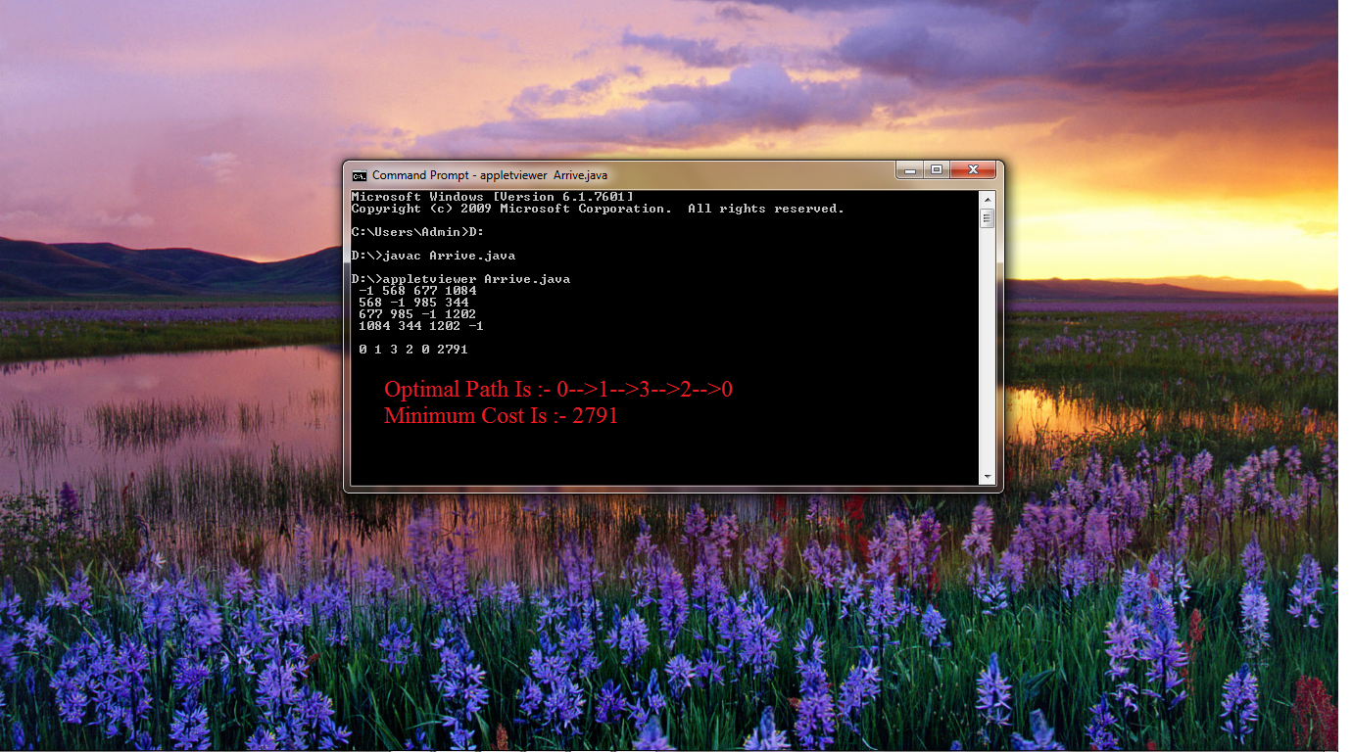

Slide 22
Some Applications
Routing the cities
Computer Wiring - connecting together computer components using minimum wire length.
Job Sequencing - sequencing jobs in order to minimise total set-up time between jobs.

Slide 23
Conclusion
The burden of the user is off-loaded to the Algorithm and the route with the least expenditure is deduced.
The user has the benefit of obtaining the optimal route in GUI by the effective implementation of the travelling salesman problem algorithm using dynamic programming.

Slide 24
Thank You

